Slide 1
Chapter 7. Cluster Analysis
What is Cluster Analysis?
Types of Data in Cluster Analysis
A Categorization of Major Clustering Methods
Partitioning Methods
Hierarchical Methods
Density-Based Methods
Grid-Based Methods
Model-Based Methods
Clustering High-Dimensional Data
Constraint-Based Clustering
Outlier Analysis
Summary

Slide 2
What is Cluster Analysis?
Cluster: a collection of data objects
  Similar to one another within the same cluster
  Dissimilar to the objects in other clusters
Cluster analysis
  Finding similarities between data according to the characteristics found in the data and grouping similar data objects into clusters
Unsupervised learning: no predefined classes
Typical applications
  As a stand-alone tool to get insight into data distribution
  As a preprocessing step for other algorithms

Slide 3
Clustering: Rich Applications and Multidisciplinary Efforts
Pattern Recognition
Spatial Data Analysis
  Create thematic maps in GIS by clustering feature spaces
  Detect spatial clusters or for other spatial mining tasks
Image Processing
Economic Science (especially market research)
WWW
  Document classification
  Cluster Weblog data to discover groups of similar access patterns

Slide 4
Examples of Clustering Applications
Marketing: Help marketers discover distinct groups in their customer bases, and then use this knowledge to develop targeted marketing programs
Land use: Identification of areas of similar land use in an earth observation database
Insurance: Identifying groups of motor insurance policy holders with a high average claim cost
City-planning: Identifying groups of houses according to their house type, value, and geographical location
Earth-quake studies: Observed earth quake epicenters should be clustered along continent faults

Slide 5
Quality: What Is Good Clustering?
A good clustering method will produce high quality clusters with
  high intra-class similarity
  low inter-class similarity
The quality of a clustering result depends on both the similarity measure used by the method and its implementation
The quality of a clustering method is also measured by its ability to discover some or all of the hidden patterns

Slide 6
Measure the Quality of Clustering
Dissimilarity/Similarity metric: Similarity is expressed in terms of a distance function, typically metric: d(i, j)
There is a separate “quality” function that measures the “goodness” of a cluster.
The definitions of distance functions are usually very different for interval-scaled, boolean, categorical, ordinal ratio, and vector variables.
Weights should be associated with different variables based on applications and data semantics.
It is hard to define “similar enough” or “good enough”
  the answer is typically highly subjective.

Slide 7
Requirements of Clustering in Data Mining
Scalability
Ability to deal with different types of attributes
Ability to handle dynamic data
Discovery of clusters with arbitrary shape
Minimal requirements for domain knowledge to determine input parameters
Able to deal with noise and outliers
Insensitive to order of input records
High dimensionality
Incorporation of user-specified constraints
Interpretability and usability

Slide 8
Chapter 7. Cluster Analysis
What is Cluster Analysis?
Types of Data in Cluster Analysis
A Categorization of Major Clustering Methods
Partitioning Methods
Hierarchical Methods
Density-Based Methods
Grid-Based Methods
Model-Based Methods
Clustering High-Dimensional Data
Constraint-Based Clustering
Outlier Analysis
Summary

Slide 9


Data Structures
Data matrix
  n x p
  object-by-variable
Dissimilarity matrix
  n x n
  object-by-object

Slide 10
Type of data in clustering analysis
Interval-scaled variables
Binary variables
Nominal, ordinal, and ratio variables
Variables of mixed types

Slide 11


Interval-scaled variables
Standardize data
  Calculate the mean absolute deviation:
  where
  Calculate the standardized measurement (z-score)
Using mean absolute deviation is more robust than using standard deviation

Slide 12


Similarity and Dissimilarity Between Objects
Distances are normally used to measure the similarity or dissimilarity between two data objects
Some popular ones include: Minkowski distance:
  where i = (x_{i1}, x_{i2}, …, x_{ip}) and j = (x_{j1}, x_{j2}, …, x_{jp}) are two p-dimensional data objects, and q is a positive integer
If q = 1, d is Manhattan distance

Slide 13

Similarity and Dissimilarity Between Objects (Cont.)
If q = 2, d is Euclidean distance:
  Properties
    d(i,j) ≥ 0
    d(i,i) = 0
    d(i,j) = d(j,i)
    d(i,j) ≤ d(i,k) + d(k,j)
Also, one can use weighted distance, parametric Pearson product moment correlation, or other disimilarity measures
Notes:
metric
L1 norm; L2 norm
Example (1,2) and (3,5)
Mahattan distance = 2+3=5
Euclidean distance=(2^2 +3^2)^1/2 = 3.61
Non-metric example:
cosine
f: rounding off

Slide 14


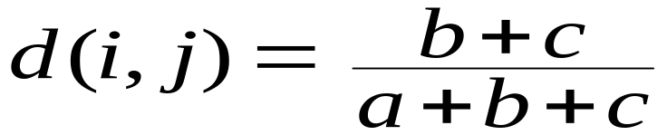
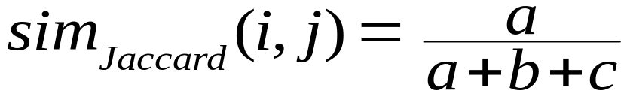
Binary Variables
Object j
A contingency table for binary data
Distance measure for symmetric binary variables:
Distance measure for asymmetric binary variables:
Jaccard coefficient (similarity measure for asymmetric binary variables):
Object i
Notes:
Symmetric: both states are equally valuable (male, female)
Asymmetric: positive or negative of disease test

Slide 15
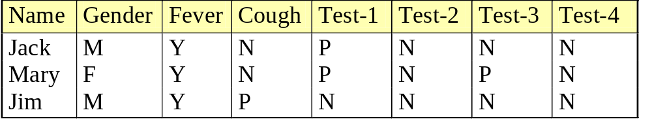

Dissimilarity between Binary Variables
Example
  gender is a symmetric attribute
  the remaining attributes are asymmetric binary
  let the values Y and P be set to 1, and the value N be set to 0
  Suppose distance is computed based on the asymmetric variables

Slide 16

Categorical Variables
A generalization of the binary variable in that it can take more than 2 states, e.g., red, yellow, blue, green
Method 1 (sym.): Simple matching
  m: # of matches, p: total # of variables
Method 2 (asym.): use a large number of binary variables
  creating a new binary variable for each of the M nominal states
Notes:
nominal

Slide 17


Ordinal Variables
An ordinal variable can be discrete or continuous
Order is important, e.g., rank
Can be treated like interval-scaled
  replace x_{if} by their rank
  map the range of each variable onto [0, 1] by replacing i-th object in the f-th variable by
  compute the dissimilarity using methods for interval-scaled variables

Slide 18
Ratio-Scaled Variables
Ratio-scaled variable: a positive measurement on a nonlinear scale, approximately at exponential scale, such as Ae^{Bt} or Ae^{-Bt}
Methods:
  treat them like interval-scaled variables—not a good choice! (why?—the scale can be distorted)
  apply logarithmic transformation
y_{if} = log(x_{if})
  treat them as continuous ordinal data treat their rank as interval-scaled

Slide 19


Variables of Mixed Types
A database may contain all the six types of variables
  symmetric binary, asymmetric binary, nominal, ordinal, interval and ratio
One may use a weighted formula to combine their effects
  f is binary or nominal:
    d_{ij}^{(f)} = 0 if x_{if} = x_{jf} , or d_{ij}^{(f)} = 1 otherwise
  f is interval-based: use the normalized distance
  f is ordinal or ratio-scaled
    compute ranks r_{if} and
    and treat z_{if} as interval-scaled
Notes:
Each variable, [0,1]

Slide 20


Vector Objects
Vector objects: keywords in documents, gene features in micro-arrays, etc.
Broad applications: information retrieval, biologic taxonomy, etc.
Cosine measure: cos(θ) =
A variant: Tanimoto coefficient
Notes:
X dot Y
---------------
||X|| ||Y||
-1: exactly opposite
1: exactly the same
0: independent
X dot Y
--------------------------------
X^2 + Y ^ 2 - X dot Y
Yields Jaccard coefficient in the case of binary variables

Slide 21
Chapter 7. Cluster Analysis
What is Cluster Analysis?
Types of Data in Cluster Analysis
A Categorization of Major Clustering Methods
Partitioning Methods
Hierarchical Methods
Density-Based Methods
Grid-Based Methods
Model-Based Methods
Clustering High-Dimensional Data
Constraint-Based Clustering
Outlier Analysis
Summary

Slide 22
Major Clustering Approaches (I)
Partitioning approach:
  Construct various partitions and then evaluate them by some criterion, e.g., minimizing the sum of square errors
  Typical methods: k-means, k-medoids, CLARANS
Hierarchical approach:
  Create a hierarchical decomposition of the set of data (or objects) using some criterion
  Typical methods: Diana, Agnes, BIRCH, ROCK, CHAMELEON
Density-based approach:
  Based on connectivity and density functions
  Typical methods: DBSCAN, OPTICS, DenClue

Slide 23
Major Clustering Approaches (II)
Grid-based approach:
  based on a multiple-level granularity structure
  Typical methods: STING, WaveCluster, CLIQUE
Model-based:
  A model is hypothesized for each of the clusters and tries to find the best fit of that model to each other
  Typical methods: EM, SOM, COBWEB
Frequent pattern-based:
  Based on the analysis of frequent patterns
  Typical methods: pCluster
User-guided or constraint-based:
  Clustering by considering user-specified or application-specific constraints
  Typical methods: COD (obstacles), constrained clustering

Slide 24
Typical Alternatives to Calculate the Distance between Clusters
Single link: smallest distance between an element in one cluster and an element in the other, i.e., dis(K_{i}, K_{j}) = min(t_{ip}, t_{jq})
Complete link: largest distance between an element in one cluster and an element in the other, i.e., dis(K_{i}, K_{j}) = max(t_{ip}, t_{jq})
Average: avg distance between an element in one cluster and an element in the other, i.e., dis(K_{i}, K_{j}) = avg(t_{ip}, t_{jq})
Centroid: distance between the centroids of two clusters, i.e., dis(K_{i}, K_{j}) = dis(C_{i}, C_{j})
Medoid: distance between the medoids of two clusters, i.e., dis(K_{i}, K_{j}) = dis(M_{i}, M_{j})
  Medoid: one chosen, centrally located object in the cluster

Slide 25
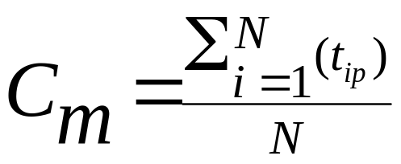
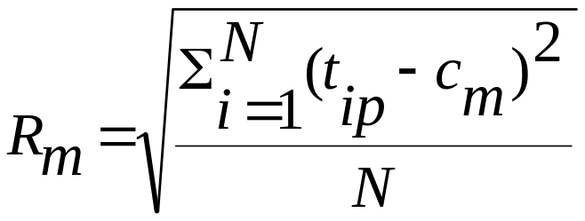

Centroid, Radius and Diameter of a Cluster (for numerical data sets)
Centroid: the “middle” of a cluster
Radius: square root of average distance from any point of the cluster to its centroid
Diameter: square root of average mean squared distance between all pairs of points in the cluster

Slide 26
Chapter 7. Cluster Analysis
What is Cluster Analysis?
Types of Data in Cluster Analysis
A Categorization of Major Clustering Methods
Partitioning Methods
Hierarchical Methods
Density-Based Methods
Grid-Based Methods
Model-Based Methods
Clustering High-Dimensional Data
Constraint-Based Clustering
Outlier Analysis
Summary

Slide 27
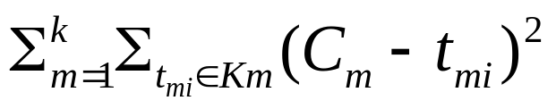
Partitioning Algorithms: Basic Concept
Partitioning method: Construct a partition of a database D of n objects into a set of k clusters, s.t., some objective is minimized. E.g., min sum of squared distance in k-means
Given a k, find a partition of k clusters that optimizes the chosen partitioning criterion
  Global optimal: exhaustively enumerate all partitions
  Heuristic methods: k-means and k-medoids algorithms
  k-means (MacQueen’67): Each cluster is represented by the center of the cluster
  k-medoids or PAM (Partition around medoids) (Kaufman & Rousseeuw’87): Each cluster is represented by one of the objects in the cluster

Slide 28
The K-Means Clustering Method
Given k, the k-means algorithm is implemented in four steps:
  Partition objects into k nonempty subsets
  Compute seed points as the centroids of the clusters of the current partition (the centroid is the center, i.e., mean point, of the cluster)
  Assign each object to the cluster with the nearest seed point
  Go back to Step 2, stop when no more new assignment

Slide 29



The K-Means Clustering Method
Example
10
10
9
9
8
8
7
7
6
6
5
5
4
Assign each objects to most similar center
Update the cluster means
4
3
3
2
2
1
1
0
0
0
1
2
3
4
5
6
7
8
9
10
0
1
2
3
4
5
6
7
8
9
10
reassign
reassign
K=2
Arbitrarily choose K object as initial cluster center
Update the cluster means

Slide 30
Comments on the K-Means Method
Strength: Relatively efficient: O(tkn), where n is # objects, k is # clusters, and t is # iterations. Normally, k, t << n.
    Comparing: PAM: O(k(n-k)² ), CLARA: O(ks² + k(n-k))
Comment: Often terminates at a local optimum. The global optimum may be found using techniques such as: deterministic annealing and genetic algorithms
Weakness
  Applicable only when mean is defined, then what about categorical data?
  Need to specify k, the number of clusters, in advance
  Unable to handle noisy data and outliers
  Not suitable to discover clusters with non-convex shapes

Slide 31
Variations of the K-Means Method
A few variants of the k-means which differ in
  Selection of the initial k means
  Dissimilarity calculations
  Strategies to calculate cluster means
Handling categorical data: k-modes (Huang’98)
  Replacing means of clusters with modes
  Using new dissimilarity measures to deal with categorical objects
  Using a frequency-based method to update modes of clusters
  A mixture of categorical and numerical data: k-prototype method

Slide 32
What Is the Problem of the K-Means Method?
The k-means algorithm is sensitive to outliers !
  Since an object with an extremely large value may substantially distort the distribution of the data.
K-Medoids: Instead of taking the mean value of the object in a cluster as a reference point, medoids can be used, which is the most centrally located object in a cluster.
10
10
9
9
8
8
7
7
6
6
5
5
4
4
3
3
2
2
1
1
0
0
1
2
3
4
5
6
7
8
9
10
0
0
1
2
3
4
5
6
7
8
9
10

Slide 33
The K-Medoids Clustering Method
Find representative objects, called medoids, in clusters
PAM (Partitioning Around Medoids, 1987)
  starts from an initial set of medoids and iteratively replaces one of the medoids by one of the non-medoids if it improves the total distance of the resulting clustering
  PAM works effectively for small data sets, but does not scale well for large data sets
CLARA (Kaufmann & Rousseeuw, 1990)
CLARANS (Ng & Han, 1994): Randomized sampling
Focusing + spatial data structure (Ester et al., 1995)

Slide 34

A Typical K-Medoids Algorithm (PAM)
Total Cost = 20
10
9
8
Arbitrary choose k object as initial medoids
Assign each remaining object to nearest medoids
7
6
5
4
3
2
1
0
0
1
2
3
4
5
6
7
8
9
10
K=2
Randomly select a nonmedoid object,O_{ramdom}
Total Cost = 26
Do loop
Until no change
10
10
9
Compute total cost of swapping
9
Swapping O and O_{ramdom}
If quality is improved.
8
8
7
7
6
6
5
5
4
4
3
3
2
2
1
1
0
0
1
2
3
4
5
6
7
8
9
10
0
0
1
2
3
4
5
6
7
8
9
10

Slide 35
PAM (Partitioning Around Medoids) (1987)
PAM (Kaufman and Rousseeuw, 1987), built in Splus
Use real object to represent the cluster
  Select k representative objects arbitrarily
  For each pair of non-selected object h and selected object i, calculate the total swapping cost TC_{ih}
  For each pair of i and h,
    If TC_{ih} < 0, i is replaced by h
    Then assign each non-selected object to the most similar representative object
  repeat steps 2-3 until there is no change

Slide 36
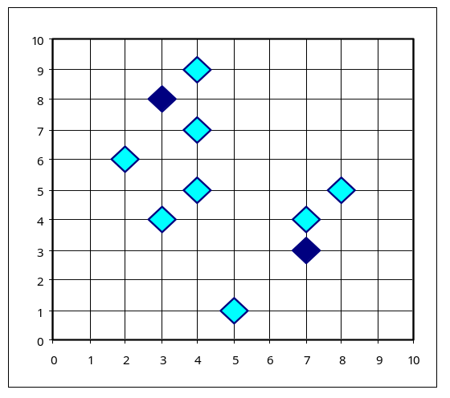
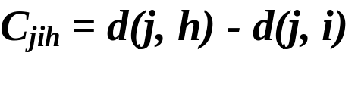

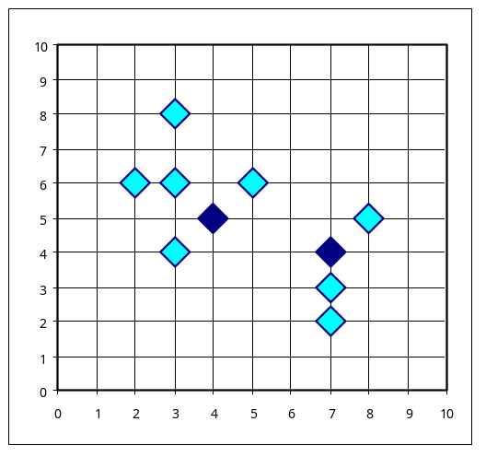
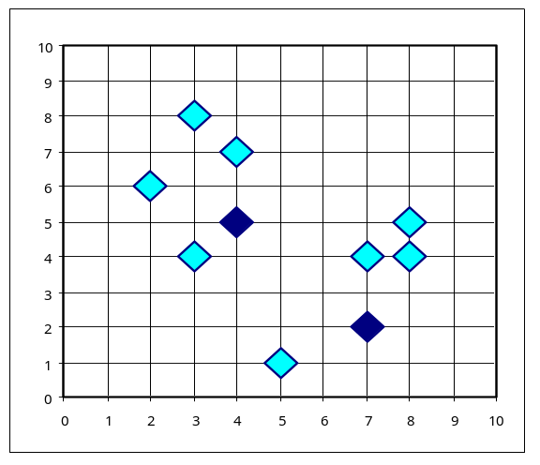


PAM Clustering: Total swapping cost TC_{ih}=∑_{j}C_{jih}
t
j
t
j
i
h
h
i
h
j
i
i
t
h
j
t
Notes:
P405, more clear

Slide 37
What Is the Problem with PAM?
Pam is more robust than k-means in the presence of noise and outliers because a medoid is less influenced by outliers or other extreme values than a mean
Pam works efficiently for small data sets but does not scale well for large data sets.
  O(k(n-k)² ) for each iteration
where n is # of data,k is # of clusters
Sampling based method,
CLARA(Clustering LARge Applications)

Slide 38
CLARA (Clustering Large Applications) (1990)
CLARA (Kaufmann and Rousseeuw in 1990)
  Built in statistical analysis packages, such as S+
It draws multiple samples of the data set, applies PAM on each sample, and gives the best clustering as the output
Strength: deals with larger data sets than PAM
Weakness:
  Efficiency depends on the sample size
  A good clustering based on samples will not necessarily represent a good clustering of the whole data set if the sample is biased

Slide 39

CLARANS (“Randomized” CLARA) (1994)
CLARANS (A Clustering Algorithm based on Randomized Search) (Ng and Han’94)
CLARANS draws sample of neighbors dynamically
The clustering process can be presented as searching a graph where every node is a potential solution, that is, a set of k medoids
If the local optimum is found, CLARANS starts with new randomly selected node in search for a new local optimum
It is more efficient and scalable than both PAM and CLARA
Focusing techniques and spatial access structures may further improve its performance (Ester et al.’95)

Slide 40
Chapter 7. Cluster Analysis
What is Cluster Analysis?
Types of Data in Cluster Analysis
A Categorization of Major Clustering Methods
Partitioning Methods
Hierarchical Methods
Density-Based Methods
Grid-Based Methods
Model-Based Methods
Clustering High-Dimensional Data
Constraint-Based Clustering
Outlier Analysis
Summary

Slide 41
Hierarchical Clustering
Use distance matrix. This method does not require the number of clusters k as an input, but needs a termination condition
Step 0
Step 1
Step 2
Step 3
Step 4
agglomerative
(AGNES)
a
a b
b
a b c d e
c
c d e
d
d e
e
divisive
(DIANA)
Step 4
Step 3
Step 2
Step 1
Step 0

Slide 42

AGNES (Agglomerative Nesting)
Introduced in Kaufmann and Rousseeuw (1990)
Implemented in statistical analysis packages, e.g., Splus
Use the Single-Link method and the dissimilarity matrix.
Merge nodes that have the least dissimilarity
Go on in a non-descending fashion
Eventually all nodes belong to the same cluster

Slide 43
Dendrogram: Shows How the Clusters are Merged
  Decompose data objects into a several levels of nested partitioning (tree of clusters), called a dendrogram.
  A clustering of the data objects is obtained by cutting the dendrogram at the desired level, then each connected component forms a cluster.
Notes:
http://home.dei.polimi.it/matteucc/Clustering/tutorial_html/AppletH.html

Slide 44
DIANA (Divisive Analysis)
Introduced in Kaufmann and Rousseeuw (1990)
Implemented in statistical analysis packages, e.g., Splus
Inverse order of AGNES
Eventually each node forms a cluster on its own

Slide 45
Recent Hierarchical Clustering Methods
Major weakness of agglomerative clustering methods
  do not scale well: time complexity of at least O(n²), where n is the number of total objects
  can never undo what was done previously
Integration of hierarchical with distance-based clustering
  BIRCH (1996): uses CF-tree and incrementally adjusts the quality of sub-clusters
  ROCK (1999): clustering categorical data by neighbor and link analysis
  CHAMELEON (1999): hierarchical clustering using dynamic modeling

Slide 46
BIRCH (1996)
Birch: Balanced Iterative Reducing and Clustering using Hierarchies (Zhang, Ramakrishnan & Livny, SIGMOD’96)
Incrementally construct a CF (Clustering Feature) tree, a hierarchical data structure for multiphase clustering
  Phase 1: scan DB to build an initial in-memory CF tree (a multi-level compression of the data that tries to preserve the inherent clustering structure of the data)
  Phase 2: use an arbitrary clustering algorithm to cluster the leaf nodes of the CF-tree
Scales linearly: finds a good clustering with a single scan and improves the quality with a few additional scans
Weakness: handles only numeric data, and sensitive to the order of the data record.
Notes:
Birch apartment. Question: if disk-resident data, how to do clustering?

Slide 47
Clustering Feature Vector in BIRCH
Clustering Feature: CF = (N, LS, SS)
N: Number of data points
LS (linear sum): ∑^{N}_{i=1} X_{i}
SS (square sum): ∑^{N}_{i=1} X_{i}²
CF = (5, (16,30),(54,190))
(3,4)
(2,6)
(4,5)
(4,7)
(3,8)
Notes:
How to summarize a cluster? Centroid, radius, diameter. Here, CF. Following similar idea, you may define CF differently

Slide 48

CF-Tree in BIRCH
Clustering feature:
  summary of the statistics for a given subcluster: the 0-th, 1st and 2nd moments of the subcluster from the statistical point of view.
  registers crucial measurements for computing cluster and utilizes storage efficiently
A CF tree is a height-balanced tree that stores the clustering features for a hierarchical clustering
  A nonleaf node in a tree has descendants or “children”
  The nonleaf nodes store sums of the CFs of their children
A CF tree has two parameters
  Branching factor: specify the maximum number of children.
  threshold: max diameter of sub-clusters stored at the leaf nodes

Slide 49
The CF Tree Structure
Root
B = 7
L = 6
CF₁
CF₂
CF₃
CF₆
child₁
child₂
child₃
child₆
Non-leaf node
CF₁
CF₂
CF₃
CF₅
child₁
child₂
child₃
child₅
Leaf node
Leaf node
prev
CF₁
CF₂
CF₆
next
prev
CF₁
CF₂
CF₄
next

Slide 50
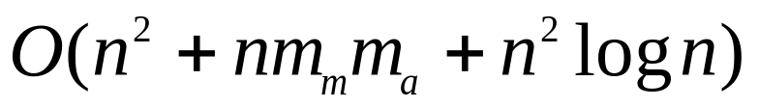
Clustering Categorical Data: The ROCK Algorithm
ROCK: RObust Clustering using linKs
  S. Guha, R. Rastogi & K. Shim, ICDE’99
Major ideas
  Use links to measure similarity/proximity
  Not distance-based
  Computational complexity:
Algorithm: sampling-based clustering
  Draw random sample
  Cluster with links
  Label data in disk
Experiments
  Congressional voting, mushroom data

Slide 51

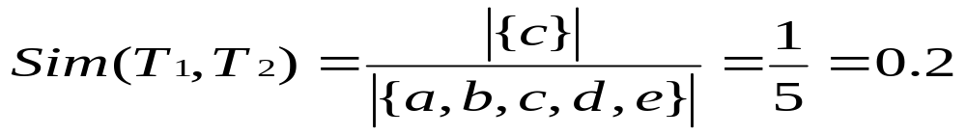
Similarity Measure in ROCK
Traditional measures for categorical data may not work well, e.g., Jaccard coefficient
Example: Two groups (clusters) of transactions
  C₁. <a, b, c, d, e>: {a, b, c}, {a, b, d}, {a, b, e}, {a, c, d}, {a, c, e}, {a, d, e}, {b, c, d}, {b, c, e}, {b, d, e}, {c, d, e}
  C₂. <a, b, f, g>: {a, b, f}, {a, b, g}, {a, f, g}, {b, f, g}
Jaccard co-efficient may lead to wrong clustering result
  C₁: 0.2 ({a, b, c}, {b, d, e}} to 0.5 ({a, b, c}, {a, b, d})
  C₁ & C₂: could be as high as 0.5 ({a, b, c}, {a, b, f})
Jaccard co-efficient-based similarity function:
  Ex. Let T₁ = {a, b, c}, T₂ = {c, d, e}

Slide 52
Link Measure in ROCK
Links: # of common neighbors
  C₁ <a, b, c, d, e>: {a, b, c}, {a, b, d}, {a, b, e}, {a, c, d}, {a, c, e}, {a, d, e}, {b, c, d}, {b, c, e}, {b, d, e}, {c, d, e}
  C₂ <a, b, f, g>: {a, b, f}, {a, b, g}, {a, f, g}, {b, f, g}
Let T₁ = {a, b, c}, T₂ = {c, d, e}, T₃ = {a, b, f}
  link(T_{1,} T₂) = 4, since they have 4 common neighbors
    {a, c, d}, {a, c, e}, {b, c, d}, {b, c, e}
  link(T_{1,} T₃) = 3, since they have 3 common neighbors
    {a, b, d}, {a, b, e}, {a, b, g}
Thus link is a better measure than Jaccard coefficient

Slide 53
CHAMELEON: Hierarchical Clustering Using Dynamic Modeling (1999)
CHAMELEON: by G. Karypis, E.H. Han, and V. Kumar’99
Measures the similarity based on a dynamic model
  Two clusters are merged only if the interconnectivity and closeness (proximity) between two clusters are high relative to the internal interconnectivity of the clusters and closeness of items within the clusters
  Cure ignores information about interconnectivity of the objects, Rock ignores information about the closeness of two clusters
A two-phase algorithm
  Use a graph partitioning algorithm: cluster objects into a large number of relatively small sub-clusters
  Use an agglomerative hierarchical clustering algorithm: find the genuine clusters by repeatedly combining these sub-clusters

Slide 54
Overall Framework of CHAMELEON
Construct
Sparse Graph
Partition the Graph
Data Set
Merge Partition
Final Clusters

Slide 55

CHAMELEON (Clustering Complex Objects)

Slide 56
Chapter 7. Cluster Analysis
What is Cluster Analysis?
Types of Data in Cluster Analysis
A Categorization of Major Clustering Methods
Partitioning Methods
Hierarchical Methods
Density-Based Methods
Grid-Based Methods
Model-Based Methods
Clustering High-Dimensional Data
Constraint-Based Clustering
Outlier Analysis
Summary

Slide 57
Density-Based Clustering Methods
Clustering based on density (local cluster criterion), such as density-connected points
Major features:
  Discover clusters of arbitrary shape
  Handle noise
  One scan
  Need density parameters as termination condition
Several interesting studies:
  DBSCAN: Ester, et al. (KDD’96)
  OPTICS: Ankerst, et al (SIGMOD’99).
  DENCLUE: Hinneburg & D. Keim (KDD’98)
  CLIQUE: Agrawal, et al. (SIGMOD’98) (more grid-based)

Slide 58
Density-Based Clustering: Basic Concepts
Two parameters:
  Eps: Maximum radius of the neighbourhood
  MinPts: Minimum number of points in an Eps-neighbourhood of that point
N_{Eps}(p): {q belongs to D | dist(p,q) <= Eps}
Directly density-reachable: A point p is directly density-reachable from a point q w.r.t. Eps, MinPts if
  p belongs to N_{Eps}(q)
  core point condition:
  |N_{Eps} (q)| >= MinPts
p
MinPts = 5
Eps = 1 cm
q
Notes:
If p is directly density reachable from q, is q directly density reachable from p? (no)

Slide 59
Density-Reachable and Density-Connected
Density-reachable:
  A point p is density-reachable from a point q w.r.t. Eps, MinPts if there is a chain of points p₁, …, p_{n}, p₁ = q, p_{n} = p such that p_{i+1} is directly density-reachable from p_{i}
Density-connected
  A point p is density-connected to a point q w.r.t. Eps, MinPts if there is a point o such that both, p and q are density-reachable from o w.r.t. Eps and MinPts
p
p₁
q
p
q
o
Notes:
If p is density reachable from q, is q density reachable from p? (no)
If p is density connected to q, is q density connected to p? (yes)

Slide 60
DBSCAN: Density Based Spatial Clustering of Applications with Noise
Relies on a density-based notion of cluster: A cluster is defined as a maximal set of density-connected points
Discovers clusters of arbitrary shape in spatial databases with noise
Outlier
Border
Eps = 1cm
MinPts = 5
Core

Slide 61
DBSCAN: The Algorithm
Arbitrary select a point p
Retrieve all points density-reachable from p w.r.t. Eps and MinPts.
If p is a core point, a cluster is formed.
If p is a border point, no points are density-reachable from p and DBSCAN visits the next point of the database.
Continue the process until all of the points have been processed.

Slide 62



DBSCAN: Sensitive to Parameters

Slide 63
OPTICS: A Cluster-Ordering Method (1999)
OPTICS: Ordering Points To Identify the Clustering Structure
  Ankerst, Breunig, Kriegel, and Sander (SIGMOD’99)
  Produces a special order of the database wrt its density-based clustering structure
  This cluster-ordering contains info equiv to the density-based clusterings corresponding to a broad range of parameter settings
  Good for both automatic and interactive cluster analysis, including finding intrinsic clustering structure
  Can be represented graphically or using visualization techniques

Slide 64
OPTICS: Some Extension from DBSCAN
Index-based:
    k = number of dimensions
    N = 20
    p = 75%
    M = N(1-p) = 5
  Complexity: O(kN²)
Core Distance
Reachability Distance
D
p1
o
p2
o
Max (core-distance (o), d (o, p))
r(p1, o) = 2.8cm. r(p2,o) = 4cm
MinPts = 5
ε = 3 cm

Slide 65


Reachability-distance
undefined
‘
Cluster-order
of the objects

Slide 66




Density-Based Clustering: OPTICS & Its Applications

Slide 67



DENCLUE: Using Statistical Density Functions
DENsity-based CLUstEring by Hinneburg & Keim (KDD’98)
Using statistical density functions:
Major features
  Solid mathematical foundation
  Good for data sets with large amounts of noise
  Allows a compact mathematical description of arbitrarily shaped clusters in high-dimensional data sets
  Significant faster than existing algorithm (e.g., DBSCAN)
  But needs a large number of parameters

Slide 68
Denclue: Technical Essence
Uses grid cells but only keeps information about grid cells that do actually contain data points and manages these cells in a tree-based access structure
Influence function: describes the impact of a data point within its neighborhood
Overall density of the data space can be calculated as the sum of the influence function of all data points
Clusters can be determined mathematically by identifying density attractors
Density attractors are local maximal of the overall density function

Slide 69



Density Attractor

Slide 70

Center-Defined and Arbitrary

Slide 71
Chapter 7. Cluster Analysis
What is Cluster Analysis?
Types of Data in Cluster Analysis
A Categorization of Major Clustering Methods
Partitioning Methods
Hierarchical Methods
Density-Based Methods
Grid-Based Methods
Model-Based Methods
Clustering High-Dimensional Data
Constraint-Based Clustering
Outlier Analysis
Summary

Slide 72
Grid-Based Clustering Method
Using multi-resolution grid data structure
Several interesting methods
  STING (a STatistical INformation Grid approach) by Wang, Yang and Muntz (1997)
  WaveCluster by Sheikholeslami, Chatterjee, and Zhang (VLDB’98)
    A multi-resolution clustering approach using wavelet method
  CLIQUE: Agrawal, et al. (SIGMOD’98)
    On high-dimensional data (thus put in the section of clustering high-dimensional data

Slide 73
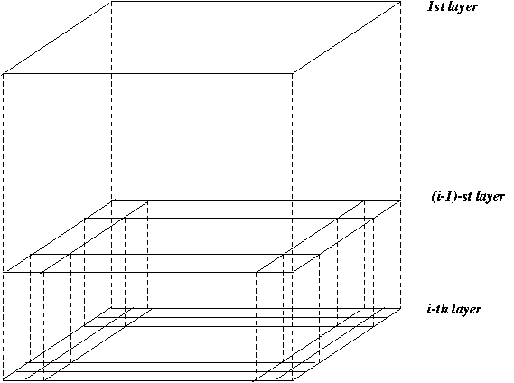
STING: A Statistical Information Grid Approach
Wang, Yang and Muntz (VLDB’97)
The spatial area area is divided into rectangular cells
There are several levels of cells corresponding to different levels of resolution

Slide 74
The STING Clustering Method
  Each cell at a high level is partitioned into a number of smaller cells in the next lower level
  Statistical info of each cell is calculated and stored beforehand and is used to answer queries
  Parameters of higher level cells can be easily calculated from parameters of lower level cell
    count, mean, s, min, max
    type of distribution—normal, uniform, etc.
  Use a top-down approach to answer spatial data queries
  Start from a pre-selected layer—typically with a small number of cells
  For each cell in the current level compute the confidence interval

Slide 75
Comments on STING
Remove the irrelevant cells from further consideration
When finish examining the current layer, proceed to the next lower level
Repeat this process until the bottom layer is reached
Advantages:
  Query-independent, easy to parallelize, incremental update
  O(K), where K is the number of grid cells at the lowest level
Disadvantages:
  All the cluster boundaries are either horizontal or vertical, and no diagonal boundary is detected

Slide 76
WaveCluster: Clustering by Wavelet Analysis (1998)
Sheikholeslami, Chatterjee, and Zhang (VLDB’98)
A multi-resolution clustering approach which applies wavelet transform to the feature space
How to apply wavelet transform to find clusters
  Summarizes the data by imposing a multidimensional grid structure onto data space
  These multidimensional spatial data objects are represented in a n-dimensional feature space
  Apply wavelet transform on feature space to find the dense regions in the feature space
  Apply wavelet transform multiple times which result in clusters at different scales from fine to coarse

Slide 77


Wavelet Transform
Wavelet transform: A signal processing technique that decomposes a signal into different frequency sub-band (can be applied to n-dimensional signals)
Data are transformed to preserve relative distance between objects at different levels of resolution
Allows natural clusters to become more distinguishable

Slide 78
The WaveCluster Algorithm
Input parameters
  # of grid cells for each dimension
  the wavelet, and the # of applications of wavelet transform
Why is wavelet transformation useful for clustering?
  Use hat-shape filters to emphasize region where points cluster, but simultaneously suppress weaker information in their boundary
  Effective removal of outliers, multi-resolution, cost effective
Major features:
  Complexity O(N)
  Detect arbitrary shaped clusters at different scales
  Not sensitive to noise, not sensitive to input order
  Only applicable to low dimensional data
Both grid-based and density-based

Slide 79


Quantization
& Transformation
First, quantize data into m-D grid structure, then wavelet transform
  a) scale 1: high resolution
  b) scale 2: medium resolution
  c) scale 3: low resolution

Slide 80
Chapter 7. Cluster Analysis
What is Cluster Analysis?
Types of Data in Cluster Analysis
A Categorization of Major Clustering Methods
Partitioning Methods
Hierarchical Methods
Density-Based Methods
Grid-Based Methods
Model-Based Methods
Clustering High-Dimensional Data
Constraint-Based Clustering
Outlier Analysis
Summary

Slide 81
Model-Based Clustering
What is model-based clustering?
  Attempt to optimize the fit between the given data and some mathematical model
  Based on the assumption: Data are generated by a mixture of underlying probability distribution
Typical methods
  Statistical approach
    EM (Expectation maximization), AutoClass
  Machine learning approach
    COBWEB, CLASSIT
  Neural network approach
    SOM (Self-Organizing Feature Map)

Slide 82
EM — Expectation Maximization
EM — A popular iterative refinement algorithm
An extension to k-means
  Assign each object to a cluster according to a weight (prob. distribution)
  New means are computed based on weighted measures
General idea
  Starts with an initial estimate of the parameter vector
  Iteratively rescores the patterns against the mixture density produced by the parameter vector
  The rescored patterns are used to update the parameter updates
  Patterns belonging to the same cluster, if they are placed by their scores in a particular component
Algorithm converges fast but may not be in global optima

Slide 83


The EM (Expectation Maximization) Algorithm
Initially, randomly assign k cluster centers
Iteratively refine the clusters based on two steps
  Expectation step: assign each data point X_{i} to cluster C_{k} with the following probability
  Maximization step:
    Estimation of model parameters
Notes:
P(Xi | Ck) = N(mk, Ek(xi)) follows the normal distribution around mean mk with expectation Ek.
i.e., in a normal distribution with mean mk and expectation Ek, the probability to observe xi
Estimation of model parameters, as in k-means, re-calculation of cluster centroid.
Difference is, in EM, all objects belongs to each cluster with some probability.
So, iteratively estimate the parameters of the normal distributions
Example: vey similar to k means. Say k=2, two normal dist. After recalculation, centroids (mk) move to better positions …
mixture of Gaussians (k normal distributions). Each distribution is a cluster

Slide 84
Conceptual Clustering
Conceptual clustering
  A form of clustering in machine learning
  Produces a classification scheme for a set of unlabeled objects
  Finds characteristic description for each concept (class)
COBWEB (Fisher’87)
  A popular a simple method of incremental conceptual learning
  Creates a hierarchical clustering in the form of a classification tree
  Each node refers to a concept and contains a probabilistic description of that concept

Slide 85

COBWEB Clustering Method
A classification tree

Slide 86
More on Conceptual Clustering
Limitations of COBWEB
  The assumption that the attributes are independent of each other is often too strong because correlation may exist
  Not suitable for clustering large database data – skewed tree and expensive probability distributions
CLASSIT
  an extension of COBWEB for incremental clustering of continuous data
  suffers similar problems as COBWEB
AutoClass (Cheeseman and Stutz, 1996)
  Uses Bayesian statistical analysis to estimate the number of clusters
  Popular in industry

Slide 87
Neural Network Approach
Neural network approaches
  Represent each cluster as an exemplar, acting as a “prototype” of the cluster
  New objects are distributed to the cluster whose exemplar is the most similar according to some distance measure
Typical methods
  SOM (Soft-Organizing feature Map)
  Competitive learning
    Involves a hierarchical architecture of several units (neurons)
    Neurons compete in a “winner-takes-all” fashion for the object currently being presented

Slide 88
Self-Organizing Feature Map (SOM)
SOMs, also called topological ordered maps, or Kohonen Self-Organizing Feature Map (KSOMs)
It maps all the points in a high-dimensional source space into a 2 to 3-d target space, s.t., the distance and proximity relationship (i.e., topology) are preserved as much as possible
Similar to k-means: cluster centers tend to lie in a low-dimensional manifold in the feature space
Clustering is performed by having several units competing for the current object
  The unit whose weight vector is closest to the current object wins
  The winner and its neighbors learn by having their weights adjusted
SOMs are believed to resemble processing that can occur in the brain
Useful for visualizing high-dimensional data in 2- or 3-D space

Slide 89
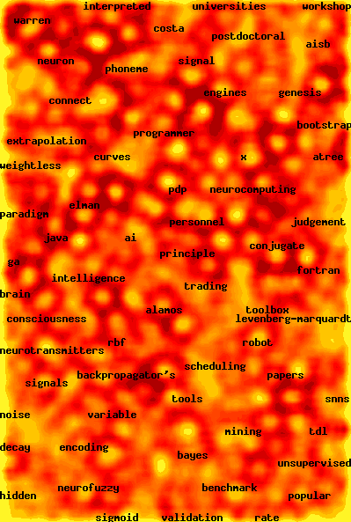
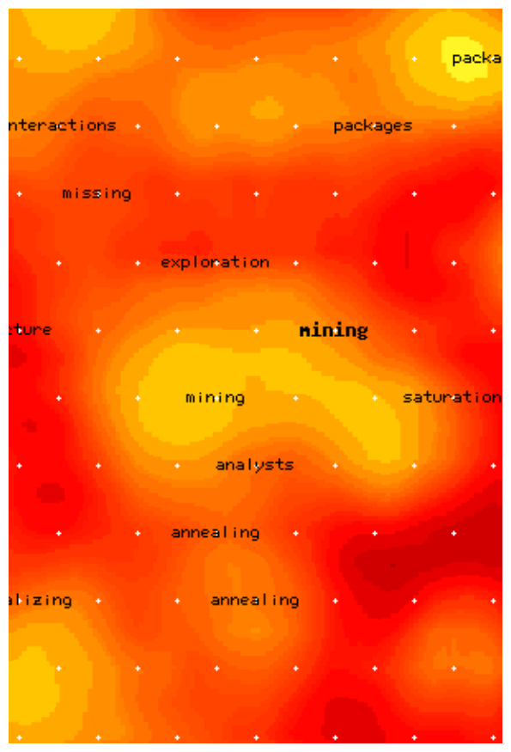
Web Document Clustering Using SOM
The result of SOM clustering of 12088 Web articles
The picture on the right: drilling down on the keyword “mining”
Based on websom.hut.fi Web page

Slide 90
Chapter 6. Cluster Analysis
What is Cluster Analysis?
Types of Data in Cluster Analysis
A Categorization of Major Clustering Methods
Partitioning Methods
Hierarchical Methods
Density-Based Methods
Grid-Based Methods
Model-Based Methods
Clustering High-Dimensional Data
Constraint-Based Clustering
Outlier Analysis
Summary

Slide 91
Clustering High-Dimensional Data
Clustering high-dimensional data
  Many applications: text documents, DNA micro-array data
  Major challenges:
    Many irrelevant dimensions may mask clusters
    Distance measure becomes meaningless—due to equi-distance
    Clusters may exist only in some subspaces
Methods
  Feature transformation: only effective if most dimensions are relevant
    PCA & SVD useful only when features are highly correlated/redundant
  Feature selection: wrapper or filter approaches
    useful to find a subspace where the data have nice clusters
  Subspace-clustering: find clusters in all the possible subspaces
    CLIQUE, ProClus, and frequent pattern-based clustering

Slide 92
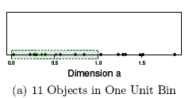
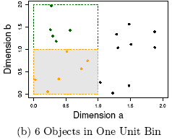
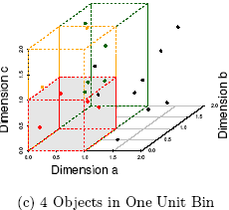
The Curse of Dimensionality
(graphs adapted from Parsons et al. KDD Explorations 2004)
Data in only one dimension is relatively packed
Adding a dimension “stretch” the points across that dimension, making them further apart
Adding more dimensions will make the points further apart—high dimensional data is extremely sparse
Distance measure becomes meaningless—due to equi-distance

Slide 93
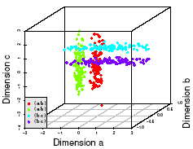
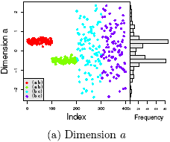
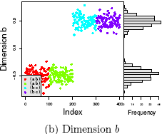
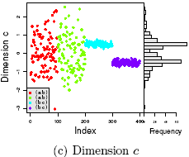
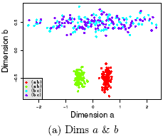
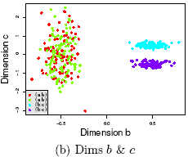
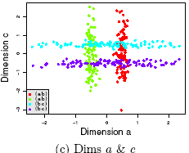
Why Subspace Clustering?
(adapted from Parsons et al. SIGKDD Explorations 2004)
Clusters may exist only in some subspaces
Subspace-clustering: find clusters in all the subspaces

Slide 94
CLIQUE (Clustering In QUEst)
Agrawal, Gehrke, Gunopulos, Raghavan (SIGMOD’98)
Automatically identifying subspaces of a high dimensional data space that allow better clustering than original space
CLIQUE can be considered as both density-based and grid-based
  It partitions each dimension into the same number of equal length interval
  It partitions an m-dimensional data space into non-overlapping rectangular units
  A unit is dense if the fraction of total data points contained in the unit exceeds the input model parameter
  A cluster is a maximal set of connected dense units within a subspace

Slide 95
CLIQUE: The Major Steps
Partition the data space and find the number of points that lie inside each cell of the partition.
Identify the subspaces that contain clusters using the Apriori principle
Identify clusters
  Determine dense units in all subspaces of interests
  Determine connected dense units in all subspaces of interests.
Generate minimal description for the clusters
  Determine maximal regions that cover a cluster of connected dense units for each cluster
  Determination of minimal cover for each cluster

Slide 96
Salary (10,000)
Vacation(week)
7
7
6
6
5
5
4
4
3
3
2
2
1
1
0
age
0
age
20
30
40
50
60
20
30
40
50
60
τ = 3
Vacation
Salary
30
50
age
Notes:
age x gpa

Slide 97
Strength and Weakness of CLIQUE
Strength
  automatically finds subspaces of the highest dimensionality such that high density clusters exist in those subspaces
  insensitive to the order of records in input and does not presume some canonical data distribution
  scales linearly with the size of input and has good scalability as the number of dimensions in the data increases
Weakness
  The accuracy of the clustering result may be degraded at the expense of simplicity of the method

Slide 98
Frequent Pattern-Based Approach
Clustering high-dimensional space (e.g., clustering text documents, microarray data)
  Projected subspace-clustering: which dimensions to be projected on?
    CLIQUE, ProClus
  Feature extraction: costly and may not be effective?
  Using frequent patterns as “features”
    “Frequent” are inherent features
    Mining freq. patterns may not be so expensive
Typical methods
  Frequent-term-based document clustering
  Clustering by pattern similarity in micro-array data (pClustering)

Slide 99
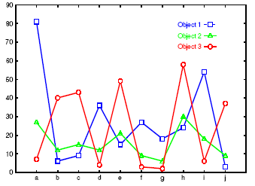
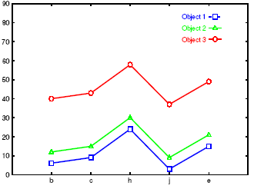
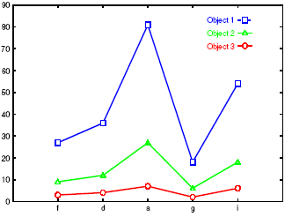
Clustering by Pattern Similarity (p-Clustering)
Right: The micro-array “raw” data shows 3 genes and their values in a multi-dimensional space
  Difficult to find their patterns
Bottom: Some subsets of dimensions form nice shift and scaling patterns
Notes:
Pattern based vs. euclidean distance based
Subspace vs. full space

Slide 100

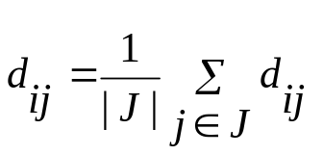
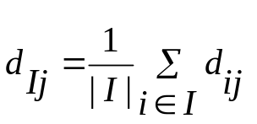
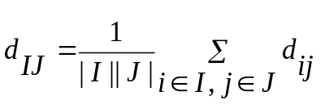
Why p-Clustering?
Microarray data analysis may need to
  Clustering on thousands of dimensions (attributes)
  Discovery of both shift and scaling patterns
Clustering with Euclidean distance measure? — cannot find shift patterns
Clustering on derived attribute A_{ij} = a_{i} – a_{j}? — introduces N(N-1) dimensions
Bi-cluster using transformed mean-squared residue score matrix (I, J)
  Where
  A submatrix is a δ-cluster if H(I, J) ≤ δ for some δ > 0
Problems with bi-cluster
  No downward closure property,
  Due to averaging, it may contain outliers but still within δ-threshold

Slide 101
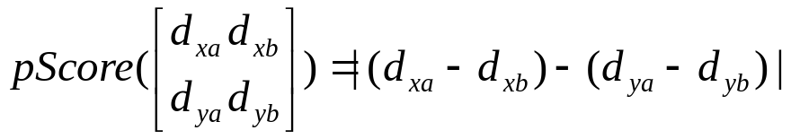
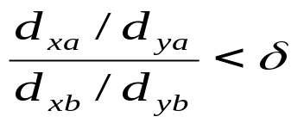
p-Clustering: Clustering by Pattern Similarity
Given object x, y in O and features a, b in T, pCluster is a 2 by 2 matrix
A pair (O, T) is in δ-pCluster if for any 2 by 2 matrix X in (O, T), pScore(X) ≤ δ for some δ > 0
Properties of δ-pCluster
  Downward closure
  Clusters are more homogeneous than bi-cluster (thus the name: pair-wise Cluster)
Pattern-growth algorithm has been developed for efficient mining
For scaling patterns, one can observe, taking logarithmic on will lead to the pScore form

Slide 102
Chapter 6. Cluster Analysis
What is Cluster Analysis?
Types of Data in Cluster Analysis
A Categorization of Major Clustering Methods
Partitioning Methods
Hierarchical Methods
Density-Based Methods
Grid-Based Methods
Model-Based Methods
Clustering High-Dimensional Data
Constraint-Based Clustering
Outlier Analysis
Summary

Slide 103
Why Constraint-Based Cluster Analysis?
Need user feedback: Users know their applications the best
Less parameters but more user-desired constraints, e.g., an ATM allocation problem: obstacle & desired clusters

Slide 104
A Classification of Constraints in Cluster Analysis
Clustering in applications: desirable to have user-guided (i.e., constrained) cluster analysis
Different constraints in cluster analysis:
  Constraints on individual objects (do selection first)
    Cluster on houses worth over $300K
  Constraints on distance or similarity functions
    Weighted functions, obstacles (e.g., rivers, lakes)
  Constraints on the selection of clustering parameters
    # of clusters, MinPts, etc.
  User-specified constraints
    Contain at least 500 valued customers and 5000 ordinary ones
  Semi-supervised: giving small training sets as “constraints” or hints

Slide 105
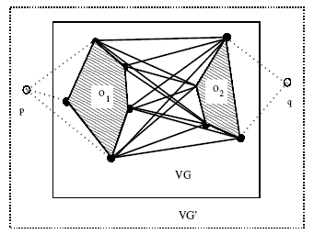
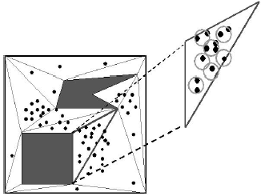
Clustering With Obstacle Objects
K-medoids is more preferable since k-means may locate the ATM center in the middle of a lake
Visibility graph and shortest path
Triangulation and micro-clustering
Two kinds of join indices (shortest-paths) worth pre-computation
  VV index: indices for any pair of obstacle vertices
  MV index: indices for any pair of micro-cluster and obstacle indices

Slide 106
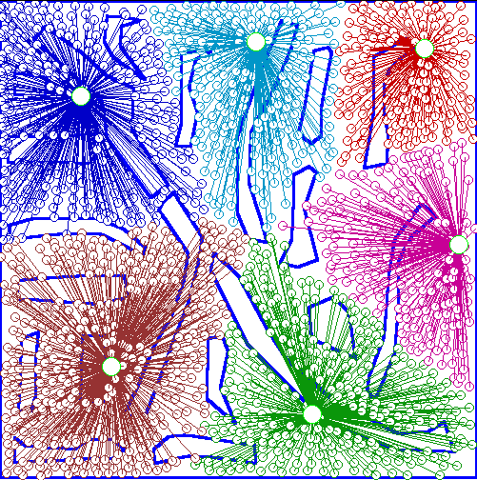
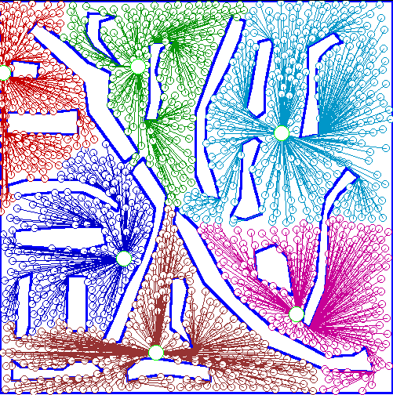
An Example: Clustering With Obstacle Objects
Not Taking obstacles into account
Taking obstacles into account

Slide 107
Clustering with User-Specified Constraints
Example: Locating k delivery centers, each serving at least m valued customers and n ordinary ones
Proposed approach
  Find an initial “solution” by partitioning the data set into k groups and satisfying user-constraints
  Iteratively refine the solution by micro-clustering relocation (e.g., moving δ μ-clusters from cluster C_{i} to C_{j}) and “deadlock” handling (break the microclusters when necessary)
  Efficiency is improved by micro-clustering
How to handle more complicated constraints?
  E.g., having approximately same number of valued customers in each cluster?! — Can you solve it?

Slide 108
Semi-supervised clustering
Must-link
Cannot-link

Slide 109
Chapter 7. Cluster Analysis
What is Cluster Analysis?
Types of Data in Cluster Analysis
A Categorization of Major Clustering Methods
Partitioning Methods
Hierarchical Methods
Density-Based Methods
Grid-Based Methods
Model-Based Methods
Clustering High-Dimensional Data
Constraint-Based Clustering
Outlier Analysis
Summary

Slide 110
What Is Outlier Discovery?
What are outliers?
  The set of objects are considerably dissimilar from the remainder of the data
  Example: Sports: Michael Jordon, Wayne Gretzky, ...
Problem: Define and find outliers in large data sets
Applications:
  Credit card fraud detection
  Telecom fraud detection
  Customer segmentation
  Medical analysis

Slide 111

Outlier Discovery: Statistical Approaches
Assume a model underlying distribution that generates data set (e.g. normal distribution)
Use discordancy tests depending on
  data distribution
  distribution parameter (e.g., mean, variance)
  number of expected outliers
Drawbacks
  most tests are for single attribute
  In many cases, data distribution may not be known

Slide 112
Outlier Discovery: Distance-Based Approach
Introduced to counter the main limitations imposed by statistical methods
  We need multi-dimensional analysis without knowing data distribution
Distance-based outlier: A DB(p, D)-outlier is an object O in a dataset T such that at least a fraction p of the objects in T lies at a distance greater than D from O
Algorithms for mining distance-based outliers
  Index-based algorithm
  Nested-loop algorithm
  Cell-based algorithm

Slide 113
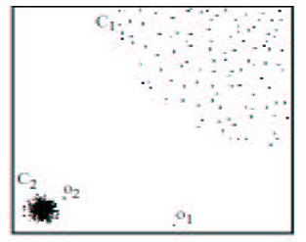
Density-Based Local Outlier Detection
Distance-based outlier detection is based on global distance distribution
It encounters difficulties to identify outliers if data is not uniformly distributed
Ex. C₁ contains 400 loosely distributed points, C₂ has 100 tightly condensed points, 2 outlier points o₁, o₂
Distance-based method cannot identify o₂ as an outlier
Need the concept of local outlier
Local outlier factor (LOF)
  Assume outlier is not crisp
  Each point has a LOF

Slide 114
Outlier Discovery: Deviation-Based Approach
Identifies outliers by examining the main characteristics of objects in a group
Objects that “deviate” from this description are considered outliers
Sequential exception technique
  simulates the way in which humans can distinguish unusual objects from among a series of supposedly like objects
OLAP data cube technique
  uses data cubes to identify regions of anomalies in large multidimensional data

Slide 115
Chapter 7. Cluster Analysis
What is Cluster Analysis?
Types of Data in Cluster Analysis
A Categorization of Major Clustering Methods
Partitioning Methods
Hierarchical Methods
Density-Based Methods
Grid-Based Methods
Model-Based Methods
Clustering High-Dimensional Data
Constraint-Based Clustering
Outlier Analysis
Summary

Slide 116
Summary
Cluster analysis groups objects based on their similarity and has wide applications
Measure of similarity can be computed for various types of data
Clustering algorithms can be categorized into partitioning methods, hierarchical methods, density-based methods, grid-based methods, and model-based methods
Outlier detection and analysis are very useful for fraud detection, etc. and can be performed by statistical, distance-based or deviation-based approaches
There are still lots of research issues on cluster analysis

Slide 117
Problems and Challenges
Considerable progress has been made in scalable clustering methods
  Partitioning: k-means, k-medoids, CLARANS
  Hierarchical: BIRCH, ROCK, CHAMELEON
  Density-based: DBSCAN, OPTICS, DenClue
  Grid-based: STING, WaveCluster, CLIQUE
  Model-based: EM, Cobweb, SOM
  Frequent pattern-based: pCluster
  Constraint-based: COD, constrained-clustering
Current clustering techniques do not address all the requirements adequately, still an active area of research

Slide 118
References (1)
R. Agrawal, J. Gehrke, D. Gunopulos, and P. Raghavan. Automatic subspace clustering of high dimensional data for data mining applications. SIGMOD'98
M. R. Anderberg. Cluster Analysis for Applications. Academic Press, 1973.
M. Ankerst, M. Breunig, H.-P. Kriegel, and J. Sander. Optics: Ordering points to identify the clustering structure, SIGMOD’99.
P. Arabie, L. J. Hubert, and G. De Soete. Clustering and Classification. World Scientific, 1996
Beil F., Ester M., Xu X.: "Frequent Term-Based Text Clustering", KDD'02
M. M. Breunig, H.-P. Kriegel, R. Ng, J. Sander. LOF: Identifying Density-Based Local Outliers. SIGMOD 2000.
M. Ester, H.-P. Kriegel, J. Sander, and X. Xu. A density-based algorithm for discovering clusters in large spatial databases. KDD'96.
M. Ester, H.-P. Kriegel, and X. Xu. Knowledge discovery in large spatial databases: Focusing techniques for efficient class identification. SSD'95.
D. Fisher. Knowledge acquisition via incremental conceptual clustering. Machine Learning, 2:139-172, 1987.
D. Gibson, J. Kleinberg, and P. Raghavan. Clustering categorical data: An approach based on dynamic systems. VLDB’98.

Slide 119
References (2)
V. Ganti, J. Gehrke, R. Ramakrishan. CACTUS Clustering Categorical Data Using Summaries. KDD'99.
D. Gibson, J. Kleinberg, and P. Raghavan. Clustering categorical data: An approach based on dynamic systems. In Proc. VLDB’98.
S. Guha, R. Rastogi, and K. Shim. Cure: An efficient clustering algorithm for large databases. SIGMOD'98.
S. Guha, R. Rastogi, and K. Shim. ROCK: A robust clustering algorithm for categorical attributes. In ICDE'99, pp. 512-521, Sydney, Australia, March 1999.
A. Hinneburg, D.l A. Keim: An Efficient Approach to Clustering in Large Multimedia Databases with Noise. KDD’98.
A. K. Jain and R. C. Dubes. Algorithms for Clustering Data. Printice Hall, 1988.
G. Karypis, E.-H. Han, and V. Kumar. CHAMELEON: A Hierarchical Clustering Algorithm Using Dynamic Modeling. COMPUTER, 32(8): 68-75, 1999.
L. Kaufman and P. J. Rousseeuw. Finding Groups in Data: an Introduction to Cluster Analysis. John Wiley & Sons, 1990.
E. Knorr and R. Ng. Algorithms for mining distance-based outliers in large datasets. VLDB’98.
G. J. McLachlan and K.E. Bkasford. Mixture Models: Inference and Applications to Clustering. John Wiley and Sons, 1988.
P. Michaud. Clustering techniques. Future Generation Computer systems, 13, 1997.
R. Ng and J. Han. Efficient and effective clustering method for spatial data mining. VLDB'94.

Slide 120
References (3)
L. Parsons, E. Haque and H. Liu, Subspace Clustering for High Dimensional Data: A Review , SIGKDD Explorations, 6(1), June 2004
E. Schikuta. Grid clustering: An efficient hierarchical clustering method for very large data sets. Proc. 1996 Int. Conf. on Pattern Recognition,.
G. Sheikholeslami, S. Chatterjee, and A. Zhang. WaveCluster: A multi-resolution clustering approach for very large spatial databases. VLDB’98.
A. K. H. Tung, J. Han, L. V. S. Lakshmanan, and R. T. Ng. Constraint-Based Clustering in Large Databases, ICDT'01.
A. K. H. Tung, J. Hou, and J. Han. Spatial Clustering in the Presence of Obstacles , ICDE'01
H. Wang, W. Wang, J. Yang, and P.S. Yu. Clustering by pattern similarity in large data sets, SIGMOD’ 02.
W. Wang, Yang, R. Muntz, STING: A Statistical Information grid Approach to Spatial Data Mining, VLDB’97.
T. Zhang, R. Ramakrishnan, and M. Livny. BIRCH : an efficient data clustering method for very large databases. SIGMOD'96.

